Slide 1
LINQ
Language Intergrated Query

Slide 2
What is LINQ?
LINQ - Language Intergrated Query can be understood as a strongly typed query language, embedded directly into the grammar of C#
“LINQ” can manipulate not only relational database but also others, including Array, Generic List<T>, etc.
“LINQ” is the term used to describe this overall approach to data access.

Slide 3
Types of data applying LINQ
LINQ to Objects: applying LINQ queries to arrays and collections.
LINQ to XML: using LINQ to manipulate and query XML documents.
LINQ to DataSet: applying LINQ queries to ADO.NET DataSet objects.
LINQ to Entities: use of LINQ queries within the ADO.NET Entity Framework (EF) API.
Parallel LINQ (PLINQ): This allows for parallel processing of data returned from a LINQ query.

Slide 4
Applying LINQ Queries to Primitive Arrays
static void QueryOverStrings()
{
// Assume we have an array of strings.
string[] currentVideoGames = {"Morrowind", "Uncharted 2",
"Fallout 3", "Daxter", "System Shock 2"};
// Build a query expression to find the items in thearray
// that have an embedded space.
IEnumerable<string> subset = from g in currentVideoGames
where g.Contains(" ") orderby g select g;
// Print out the results.
foreach (string s in subset)
Console.WriteLine("Item: {0}", s);
}
“Give me the items inside of currentVideoGames that contain a space, ordered alphabetically.”

Slide 5
Without LINQ
static void QueryOverStringsLongHand()
{
// Assume we have an array of strings.
string[] currentVideoGames = {"Morrowind", "Uncharted 2",
"Fallout 3", "Daxter", "System Shock 2"};
string[] gamesWithSpaces = new string[5];
for (int i = 0; i < currentVideoGames.Length; i++)
{
if (currentVideoGames[i].Contains(" "))
gamesWithSpaces[i] = currentVideoGames[i];
}
// Now sort them.
Array.Sort(gamesWithSpaces);
// Print out the results.
foreach (string s in gamesWithSpaces)
{
if( s != null)
Console.WriteLine("Item: {0}", s);
}
Console.WriteLine();
}

Slide 6
LINQ and Implicitly Typed Local Variables
static void QueryOverInts()
{
int[] numbers = {10, 20, 30, 40, 1, 2, 3, 8};
// Use implicit typing here...
var subset = from i in numbers where i < 10 select i;
// ...and here.
foreach (var i in subset)
Console.WriteLine("Item: {0} ", i);}
Should make use of implicit typing when capturing the results of a LINQ query.

Slide 7
Note
class LINQBasedFieldsAreClunky
{
private static string[] currentVideoGames = {"Morrowind", "Uncharted 2", "Fallout 3", "Daxter", "System Shock 2"};
// Can't use implicit typing here! Must know type of subset!
private IEnumerable<string> subset = from g in currentVideoGames
where g.Contains(" ") orderby g select g;
public void PrintGames()
{
foreach (var item in subset)
{
Console.WriteLine(item);
}
}
}

Slide 8
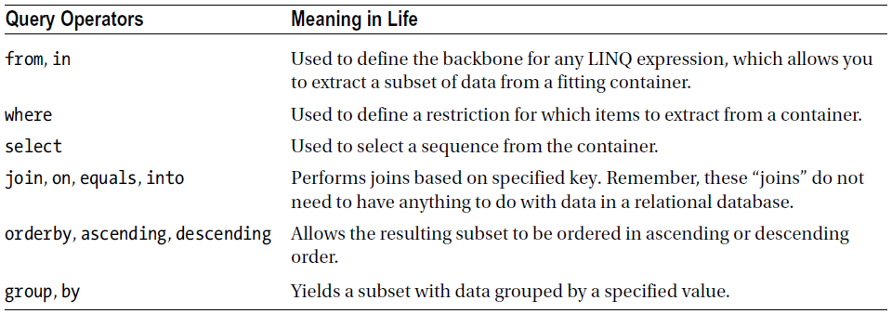
Investigating the C# LINQ Query Operators
Extension methods: ToArray<>(), ToList<>(), Reverse<>(), Distinct<>(), Union<>(), Intersect<>(), Count<>(), Sum<>(), Min<>(), Max<>(), etc

Slide 9
Basic Selection Syntax
static void SelectEverything(ProductInfo[] products)
{
// Get everything!
Console.WriteLine("All product details:");
var allProducts = from p in products select p;
foreach (var prod in allProducts)
Console.WriteLine(prod.ToString());
}
static void ListProductNames(ProductInfo[] products)
{
// Now get only the names of the products.
Console.WriteLine("Only product names:");
var names = from p in products select p.Name;
foreach (var n in names)
Console.WriteLine("Name: {0}", n);
}
LINQ Syntax

Slide 10
Obtaining Subsets of Data
static void GetOverstock(ProductInfo[] products)
{
Console.WriteLine("The overstock items!");
// Get only the items where we have more than
// 25 in stock.
var overstock = from p in products where p.NumberInStock > 25 select p;
foreach (ProductInfo c in overstock)
{
Console.WriteLine(c.ToString());
}
}

Slide 11
Projecting New Data Types
static void GetNamesAndDescriptions(ProductInfo[] products)
{
Console.WriteLine("Names and Descriptions:");
var nameDesc = from p in products
select new { p.Name, p.Description };
foreach (var item in nameDesc)
{
// Could also use Name
// and Description properties directly.
Console.WriteLine(item.ToString());
}
}

Slide 12
Extension Methods
// Get count from the query.
int numb =
(from g in currentVideoGames where g.Length > 6 select g).Count();
// Reverse product list
var allProducts = (from p in products select p).Reverse();
// Get names of products, alphabetized.
var subset = from p in products orderby p.Name select p;

Slide 13
Extension Methods
List<string> myCars = new List<string> { "Yugo", "Aztec", "BMW" };
List<string> yourCars = new List<string> { "BMW", "Saab", "Aztec" };
// Get the common members.
var carIntersect = (from c in myCars select c)
.Intersect(from c2 in yourCars select c2);
// Get the union of these containers.
var carUnion = (from c in myCars select c)
.Union(from c2 in yourCars select c2);
var carConcat = (from c in myCars select c)
.Concat(from c2 in yourCars select c2);
var distinctCarConcat = carConcat.Distinct();

Slide 14
Using the Enumerable Type and Lambda Expressions
static void QueryStringsWithEnumerableAndLambdas()
{
Console.WriteLine("***** Using Enumerable / Lambda Expressions *****");
string[] currentVideoGames = {"Morrowind", "Uncharted 2",
"Fallout 3", "Daxter", "System Shock 2"};
// Build a query expression using extension methods
// granted to the Array via the Enumerable type.
var subset = currentVideoGames
.Where(game => game.Contains(" "))
.OrderBy(game => game)
.Select(game => game);
// Print out the results.
foreach (var game in subset)
Console.WriteLine("Item: {0}", game);
Console.WriteLine();
}

